Slide 1

The Experience
Priyesh Chikhaliya
Software engineer trainee

Slide 2
Content
Projects
Microsoft Build
Power Apps
Collaborative apps and Low code

Slide 3
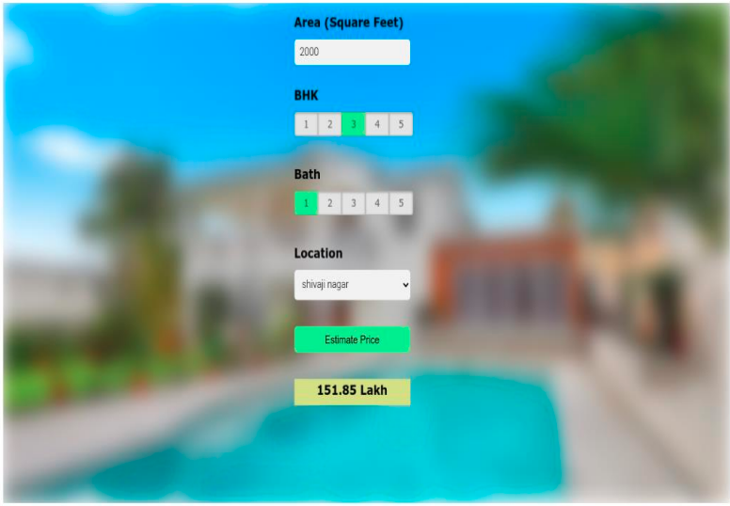
House Price Prediction

Slide 4
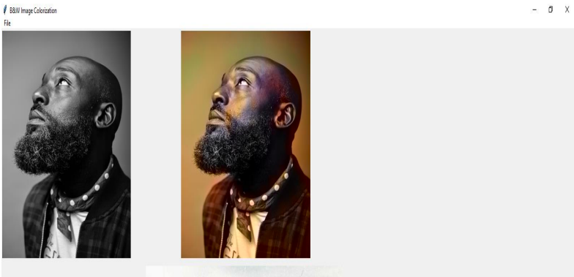
Colorize B&W Images

